Slide 1
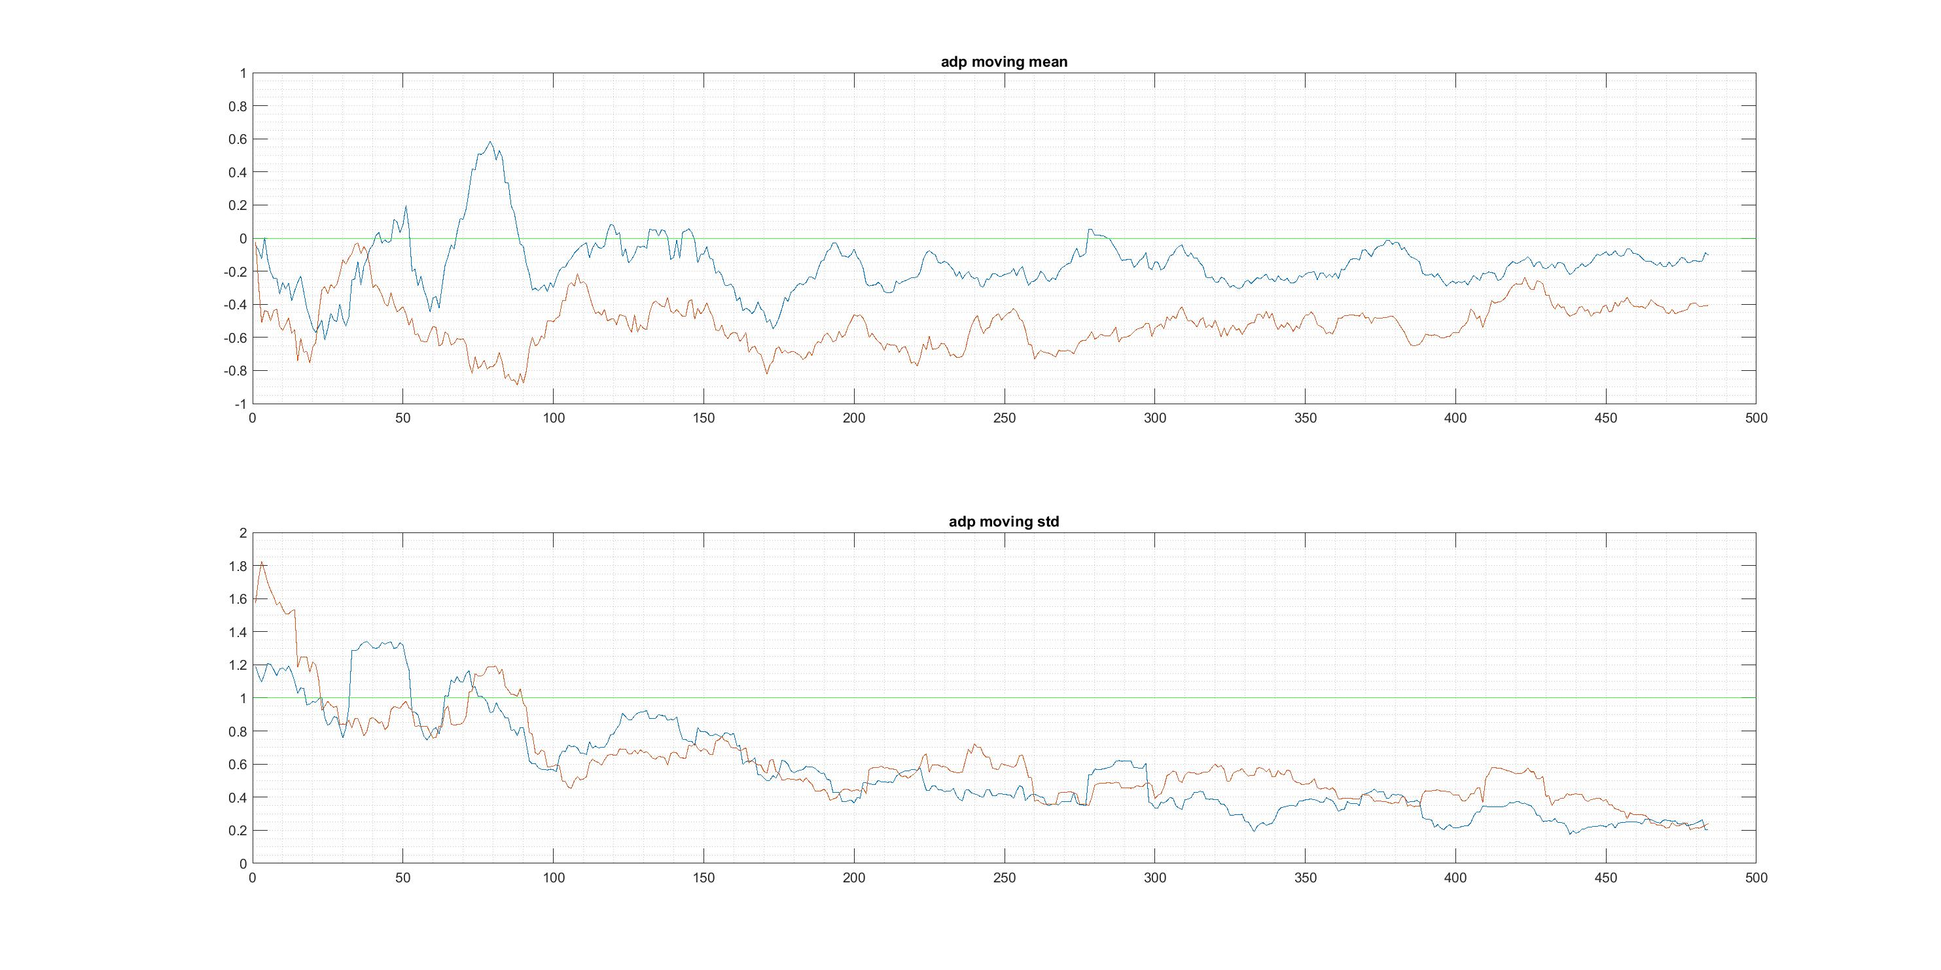
Find cutoff value of dfof_adapter for thresholding

Slide 2
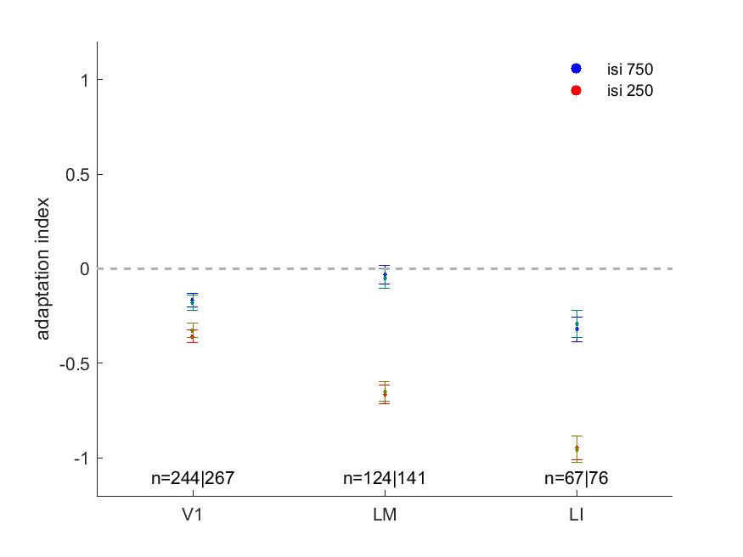
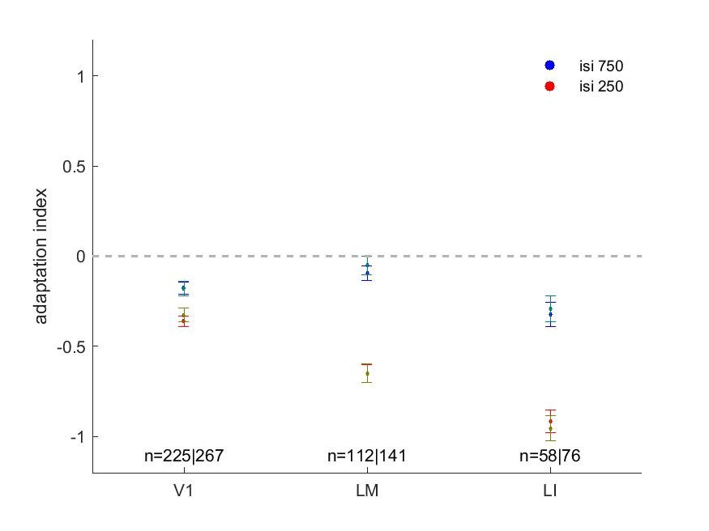
Limited impact of thresholding on adaptation magnitude

